Slide 1
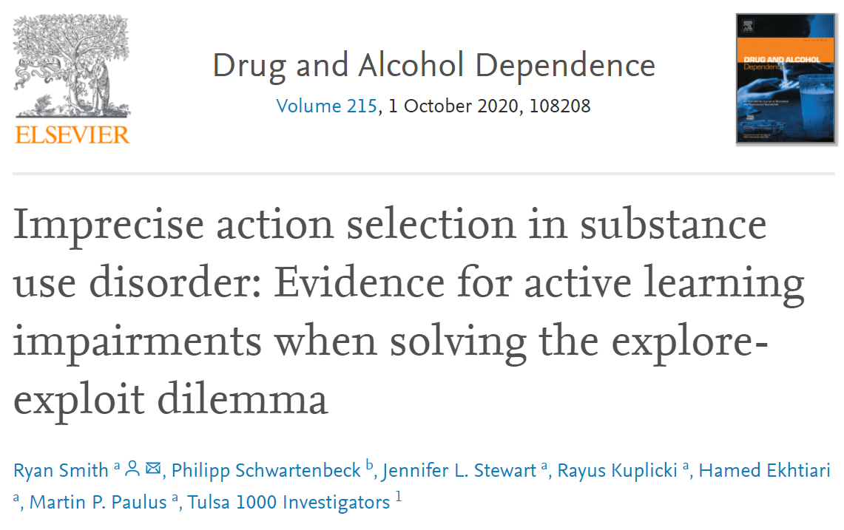
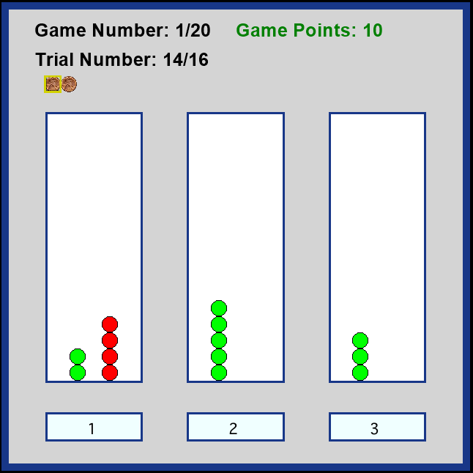
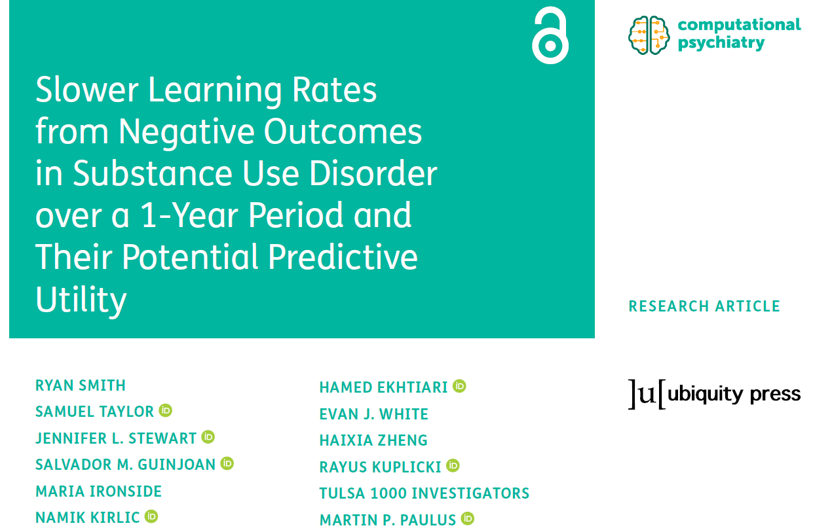
Three-armed bandit task
Three “slot machines” with unknown reward probabilities

Slide 2
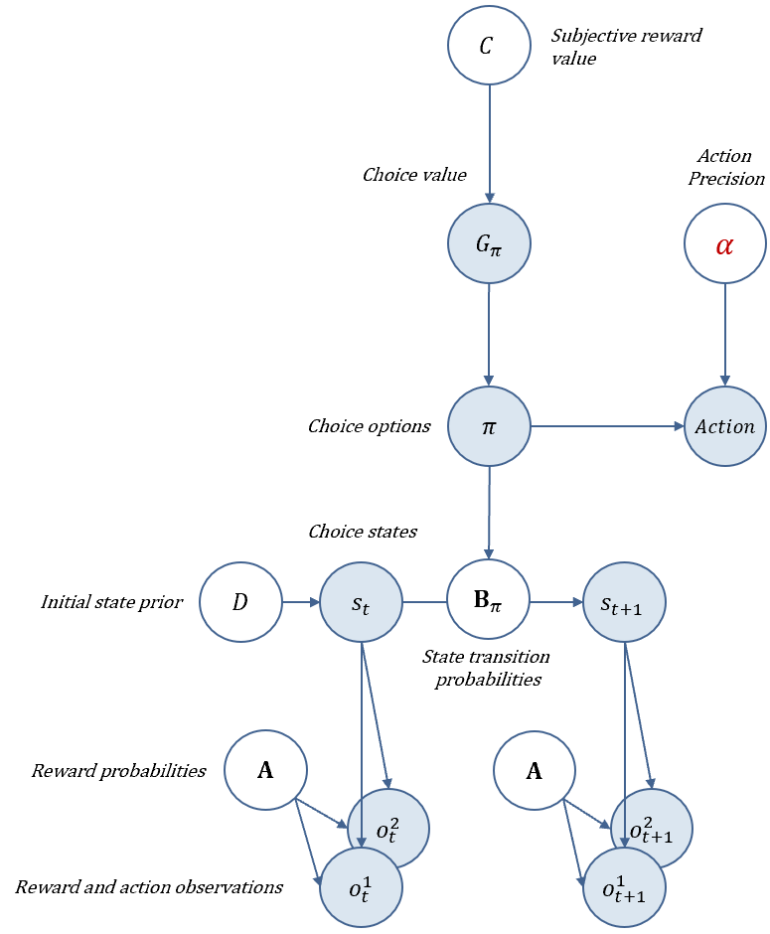
Three-armed bandit task model
Three “slot machines” with unknown reward probabilities

Slide 3

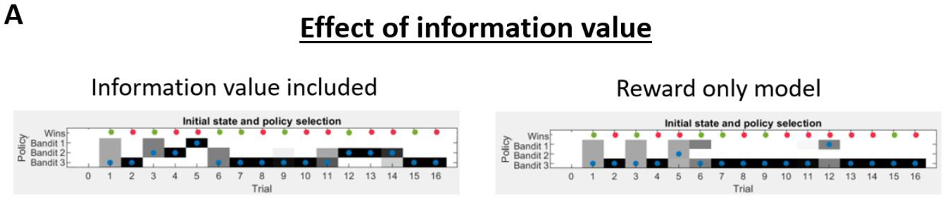
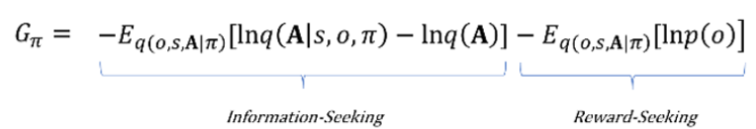
Active Learning
1
2
3
Three slot machines with unknown reward probabilities

Slide 4
Active Learning
1
2
3
Three slot machines with unknown reward probabilities

Slide 5
Active Learning
1
2
3
Three slot machines with unknown reward probabilities

Slide 6
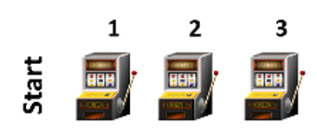
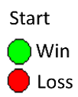
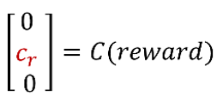
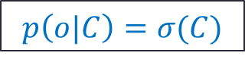
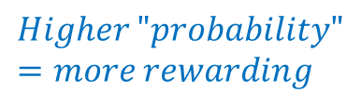

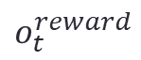

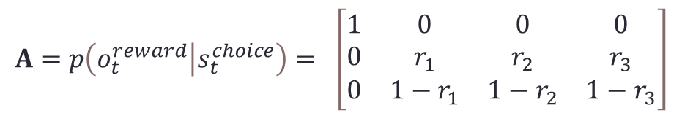
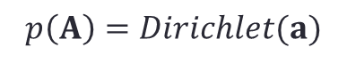
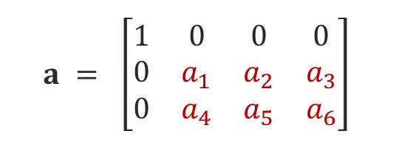
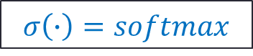
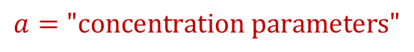
Learning Reward probabilities
$$σ\left(∙\right)=softmax$$
$$Larger=more rewarding$$
$$s_{t}^{choice}=$$
$$A=p\left(o_{t}^{reward} | s_{t}^{choice}\right)= \left[\begin{matrix}1 & 0 & 0 & 0 \\ 0 & r_{1} & r_{2} & r_{3} \\ 0 & {1−r}_{1} & 1−r_{2} & 1−r_{3}\end{matrix}\right]$$
$$p\left(A\right)=Dirichlet(a)$$
$$o_{t}^{reward}$$
$$p\left(o|C\right)=σ(C)$$
$$a = \left[\begin{matrix}1 & 0 & 0 & 0 \\ 0 & a_{1} & a_{2} & a_{3} \\ 0 & a_{4} & a_{5} & a_{6}\end{matrix}\right]$$
$$Higher "probability"=more rewarding$$
$$a=\text{"}\text{concentration} \text{parameters}\text{"}$$
Count how many times you won/lost after each choice

Slide 7
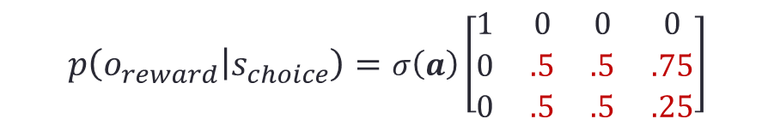
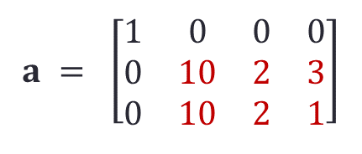
Learning Reward probabilities
$$σ\left(∙\right)=softmax$$
$$Larger=more rewarding$$
$$s_{t}^{choice}=$$
$$A=p\left(o_{t}^{reward} | s_{t}^{choice}\right)= \left[\begin{matrix}1 & 0 & 0 & 0 \\ 0 & r_{1} & r_{2} & r_{3} \\ 0 & {1−r}_{1} & 1−r_{2} & 1−r_{3}\end{matrix}\right]$$
$$p\left(A\right)=Dirichlet(a)$$
“Counts”
$$p\left(o|C\right)=σ(C)$$
$$o_{t}^{reward}$$
$$a = \left[\begin{matrix}1 & 0 & 0 & 0 \\ 0 & 10 & 2 & 3 \\ 0 & 10 & 2 & 1\end{matrix}\right]$$
$$Higher "probability"=more rewarding$$
$$p\left(o_{reward} | s_{choice}\right)=σ\left(a\right)\left[\begin{matrix}1 & 0 & 0 & 0 \\ 0 & .5 & .5 & .75 \\ 0 & .5 & .5 & .25\end{matrix}\right]$$
$$a=\text{"}\text{concentration} \text{parameters}\text{"}$$
Count how many times you won/lost after each choice

Slide 8
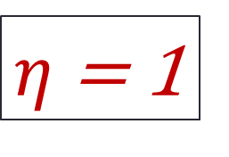
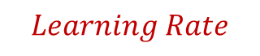
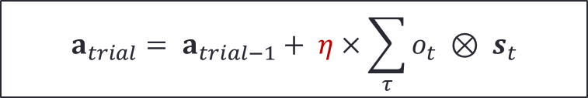
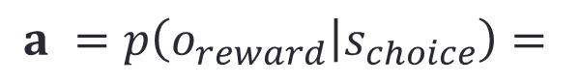
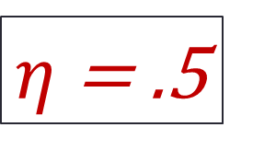
Learning Reward probabilities
$η$ = .5
$$a =p\left(o_{reward} | s_{choice}\right)=$$
$η$ = 1
Reward probability
Choose #2 and observe a win
.2 1.2 .2
.2 .2 .2
.2 .7 .2
.2 .2 .2
5 5 5
5 5 5
5 5.5 5
5 5 5
.2 .2 .2
.2 .2 .2
$$a_{trial}= a_{trial−1}+ η×\sum_{τ}{o_{t} ⊗ s_{t}}$$
$$Learning Rate$$

Slide 9

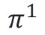
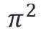
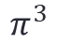
Policies ($π$): Which state do I transition to?
$$π^{3}$$
Based on both expected reward and expected information gain
(i.e., confidence in the reward probabilities)
$$π^{2}$$
$$π^{1}$$
Reward probability
Choose #2 and observe a win
5 5.5 5
5 5 5
.2 1.2 .2
.2 .2 .2
.2 .7 .2
.2 .2 .2
5 5 5
5 5 5
5 5.5 5
5 5 5
.2 .2 .2
.2 .2 .2

Slide 10
Policies ($π$): Which state do I transition to?
$$π^{3}$$
Based on both expected reward and expected information gain
(i.e., confidence in the reward probabilities)
$$π^{2}$$
$$π^{1}$$
Reward probability
Choose #2 and observe a win
5 5.5 5
5 5 5
.2 1.2 .2
.2 .2 .2
.2 .7 .2
.2 .2 .2
.2 .2 .2
.2 .2 .2

Slide 11

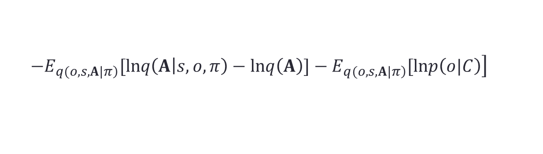
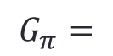


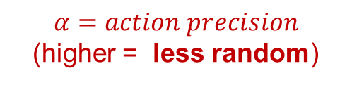
$$σ\left(∙\right)=softmax$$
$α=action precision$ (higher = less random)
$$c_{r}=reward sensitivity$$
(higher = greater reward-seeking drive)
$$a_{0}=information sensitivity$$
(higher = quicker switch to exploitation)
$$η=learning rate$$
(can be separated for wins and losses)
$$G_{π}=$$
$$\left.−Ε_{\left.q(o,s,A|π\right)}[lnq\left(A | s,o,π\right)−lnq\left(A\right)]−Ε_{\left.q(o,s,A|π\right)}[lnp\left(o|C\right)\right]$$

Slide 12
Move to code (TAB_example.m)

Slide 13
Parameter value estimates for each participant
Can address interesting questions in empirical studies:
Individuals with substance use disorders show
Three-armed bandit task

Slide 14
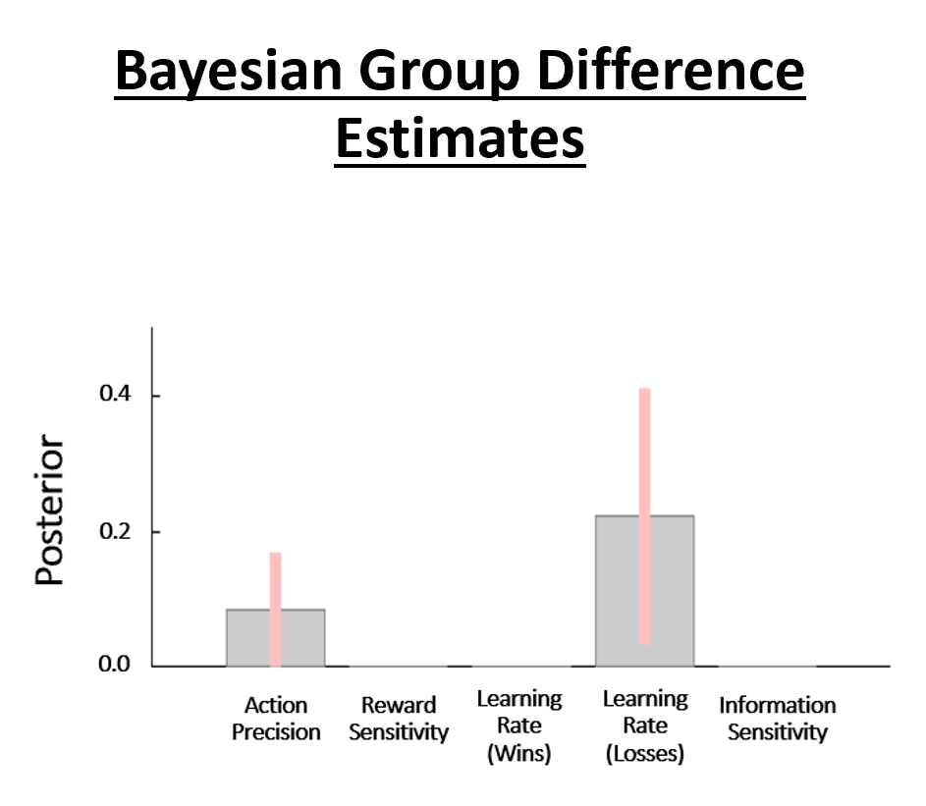
Parameter value estimates for each participant
Can address interesting questions in empirical studies:
Individuals with substance use disorders show
lower action precision
slower learning rate from losses
Three-armed bandit task

Slide 15
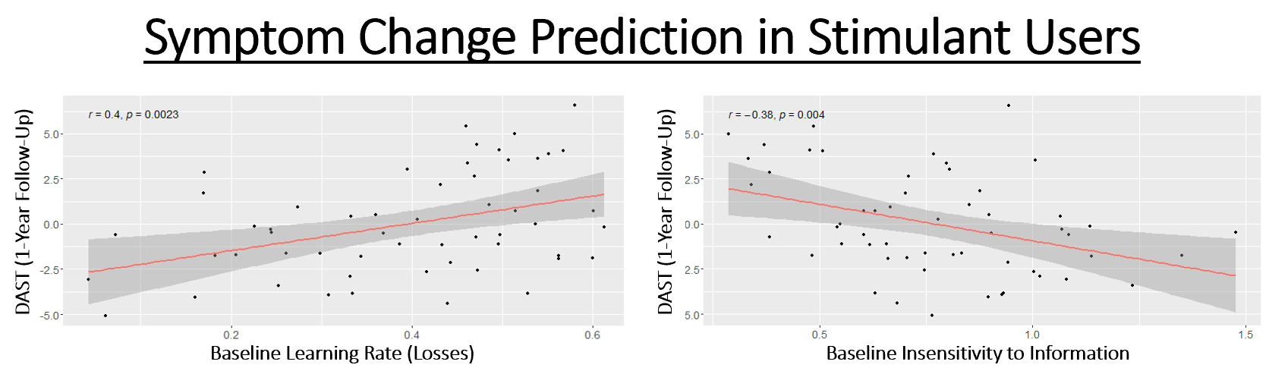
Parameter value estimates for each participant
Parameter values at baseline were also associated with changes in substance use severity over the following year

Slide 16
Steps for empirical modelling
Select and run parameter estimation algorithm for each model being considered
Perform Bayesian model comparison to confirm the best model.
Model checking: Generate simulated behavior in the best model, and then estimate parameters using this simulated behavior.
Confirm that estimates approach the parameter values used to generate the simulated behavior.
Confirm that generative and estimated parameter values are strongly correlated.
Run regression or group comparison analyses on parameters at the between-subjects level.

Slide 17
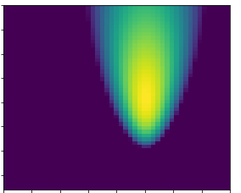
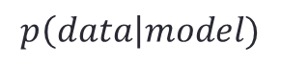
Select and run parameter estimation algorithm
Several approaches with varying levels of complexity
Simplest is a grid search
Only works in simple models with a small number of parameters
$$p\left(data\right|model)$$
8
Parameter 2
(e.g., preference precision)
Best fit
0
0
1
Parameter 1 (e.g., learning rate)

Slide 18
Move to code (fit_demo.m)

Slide 19
Select and run parameter estimation algorithm
Several approaches with varying levels of complexity
For this example, we will use one leading approach called Variational Bayes
Works well for complex models with larger numbers of parameters
This uses iterative updating to find parameter values that minimize variational free energy
Same thing that active inference models do to accomplish state inference
You start by specifying some initial estimation priors for each parameter with a mean and a variance
Estimation moves from those priors to posteriors over parameters
Maximizes accuracy while minimizing movement from prior values
Smaller prior variance deters overfitting

Slide 20
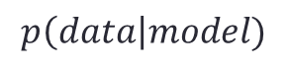
$$p\left(data\right|model)$$
8
Prior value
Several approaches with varying levels of complexity
For this example, we will use one leading approach called Variational Bayes
Works well for complex models with larger numbers of parameters
This uses iterative updating to find parameter values that minimize variational free energy
Same thing that active inference models do to accomplish state estimation!
You start by specifying some initial estimation priors for each parameter with a mean and a variance
Estimation moves from those priors to posteriors over parameters
Maximizes accuracy while minimizing movement from prior values
Smaller prior variance deters overfitting
Posterior Value
Parameter 2
(e.g., preference precision)
0
0
1
Parameter 1 (e.g., learning rate)

Slide 21
$$p\left(data\right|model)$$
8
Several approaches with varying levels of complexity
For this example, we will use one leading approach called Variational Bayes
Works well for complex models with larger numbers of parameters
This uses iterative updating to find parameter values that
You might try multiple starting priors to make sure they give you similar (correlated) posterior estimates
Parameter 2
(e.g., preference precision)
Posterior Value
Prior value
0
0
1
Parameter 1 (e.g., learning rate)

Slide 22
Select and run parameter estimation algorithm
Check to make sure convergence is smooth

Slide 23
Move to code (TAB_demo_main.m)

Slide 24
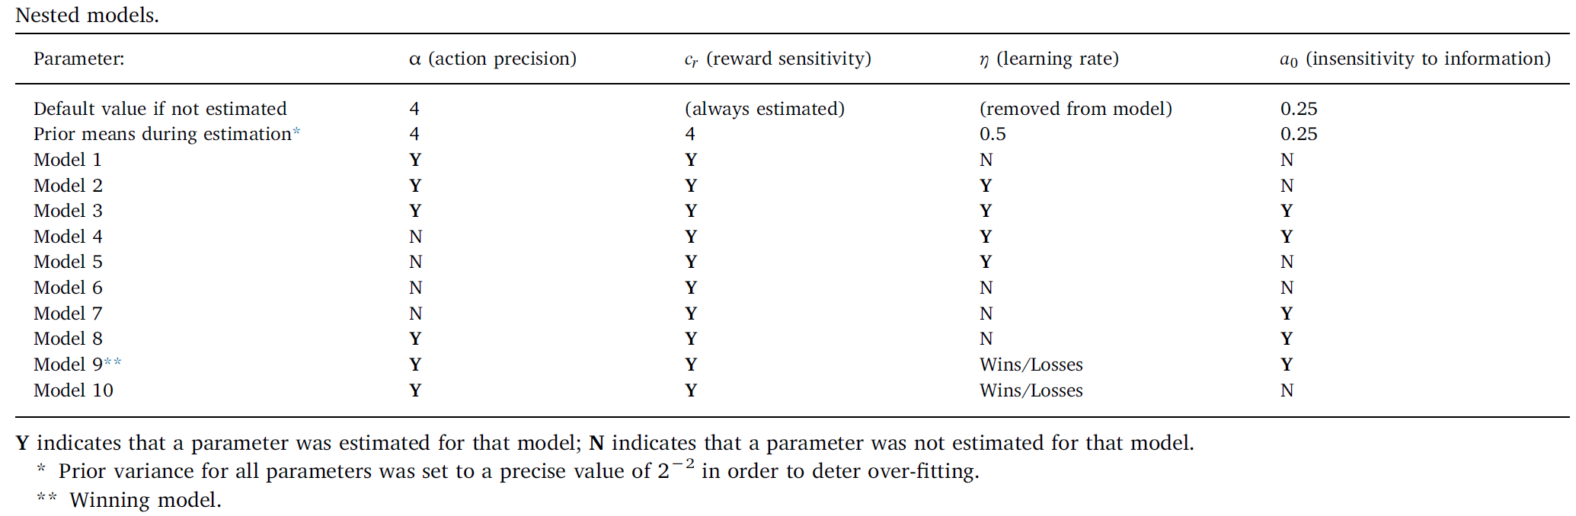
Bayesian Model Comparison
Create several different task models
Can be same model structure but including/removing different parameters
Compare the free energies of each fitted model for each participant
Model with the lowest free energy across participants is the one that best explains the data

Slide 25
Bayesian Model Comparison
Create several different task models
Can be same model structure but including/removing different parameters
Compare the free energies of each fitted model for each participant
Model with the lowest free energy across participants is the one that best explains the data
spm_BMS.m function
Move to code (TAB_demo_main.m)

Slide 26
Model checking
You need to make sure that the parameter estimates in your winning model are reliable
One way to do that is to generate simulated data using different parameters
then try to estimate parameters from the simulated data
If the estimated parameters are similar to the true parameters you used to generate the simulated behavior
then this supports reliability
Similar considerations with model identifiability
If they’re not similar, this suggests multiple parameter combinations that could explain data equally well
E.g., high learning rate and low action precision or low learning rate and high action precision might produce the same behavior in simulations
In this case, parameter estimates may not provide a uniquely best explanation for the data

Slide 27
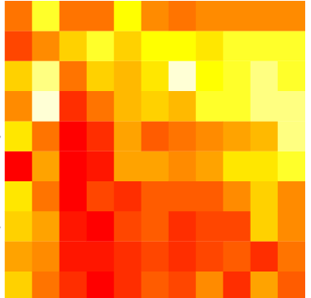
Model checking
If they’re not similar, this suggests there may be multiple parameter combinations that could explain data equally well
Equally good
If a grid search were possible
Action precision
Learning rate

Slide 28
Model identifiability
Generate simulated data from models with different numbers of parameters
Data from a model with only action precision and reward sensitivity (with all other parameters at fixed values)
Data from a model that also includes learning rate
Fit each set of data to each model
Check if model comparison identifies the right model

Slide 29
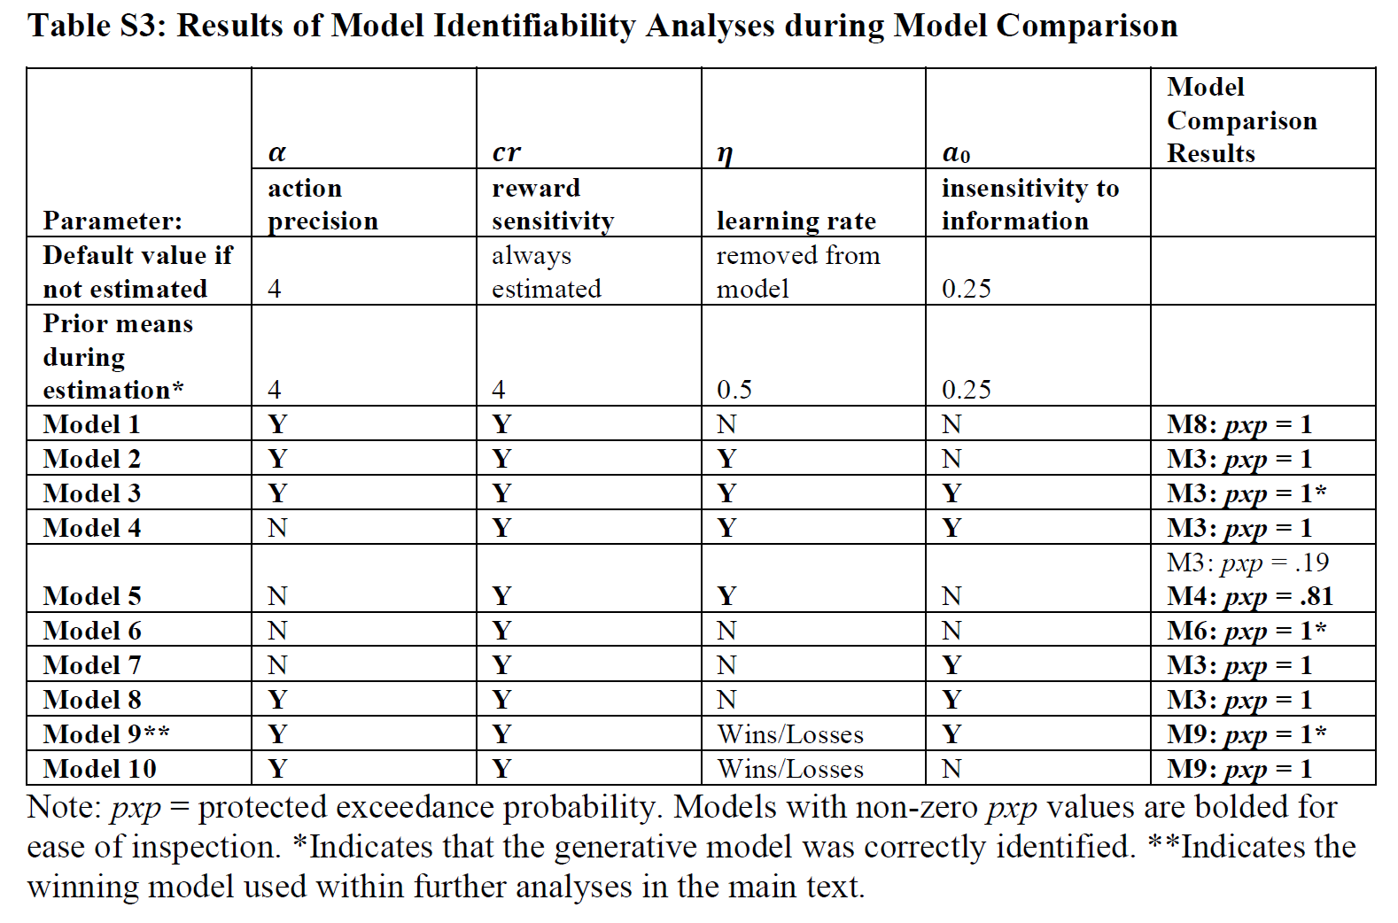
Model identifiability

Slide 30
Steps to determine parameter estimate reliability

Slide 31
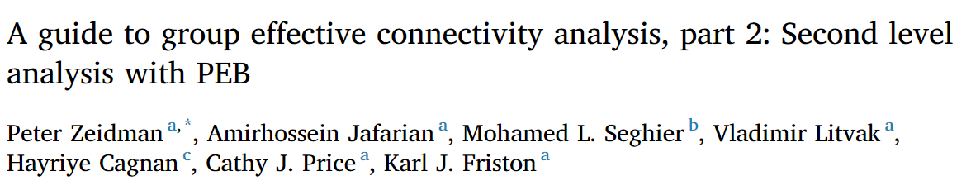
Group-level analyses
You could simply take the posterior parameter mean estimates and use them as predictors or outcome variables.
For example, is learning rate faster in those with higher anxiety?
Is depression associated with lower information-seeking?
However, variational Bayes also gives you posterior variances (confidence around mean estimates)
Some approaches allow you to incorporate that information
For example, by down-weighting estimates with high posterior variance

Slide 32
Parametric Empirical Bayes (PEB)
PEB uses a general linear model and does Bayesian model comparison between models with and without relationships between predictors and each parameter
While incorporating posterior parameter variances
Retains the reduced model (removing one or more predictors) with the most evidence
Or a full model could win

Slide 33
Select and run parameter estimation algorithm

Slide 34
Select and run parameter estimation algorithm

Slide 35
Steps for empirical modelling using this example approach
Select estimation priors, including prior means and variances.
Run variational Bayes on participant data for each model under consideration.
Check that iterative updating (gradient descent) shows smooth convergence toward a free energy minimum.
Perform Bayesian model comparison to confirm the best model.
Generate simulated behavior in the best model using the parameter values estimated in your participants, and then run variational Bayes to estimate parameters using this simulated behavior.
Confirm that posterior estimates approach the parameter values used to generate the simulated behavior.
Confirm that posterior co-variances are not high.
Confirm that generative and estimated parameter values are strongly correlated.
Use PEB to run regression or group comparison analyses on posterior means and variances at the between-subjects level.

Slide 36
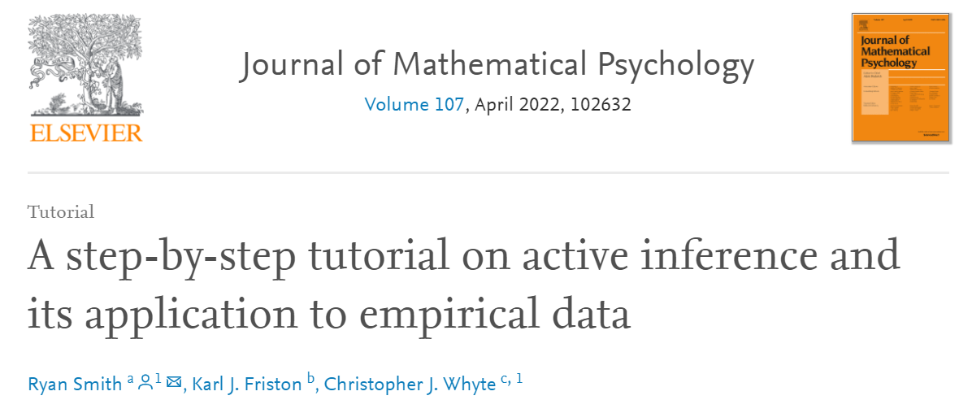
More detailed walkthrough of foundational background information:
https://medicine.yale.edu/psychiatry/education/map/support/ryan/
(Video is at the very bottom of the page)

